Slide 1
Brand Positioning Workshop
Distilling the essence of the brand

Slide 2
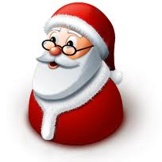
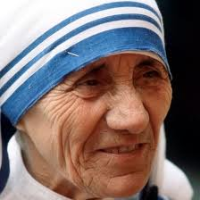
What’s a brand?
Most Unique
Most Relevant
Large Following

Slide 3
Don’t be a commodity. Be a brand.

Slide 4
What is Brand Positioning?

Slide 5
It starts with customer insights
1
The foundation of business planning
2
Attitudes never static
3
The key to building a discriminator
Discussion time
What key consumer insight(s) did these brands build upon for their success?
Salesforce
Dove
LinkedIn
Instagram
Scooty

Slide 6
Where do insights come from?
Insights
Observation
Usage
Probe
1. “Why we buy” – a study on shopping insights (Observation)
2. Google Analytics, KISSmetrics, HubSpot, Mixpanel (Usage)
3. Quantitative | Qualitative; Paper/Pen | Online | Telephonic (Probe)

Slide 7
Product proposition
1
Filters down from consumer insights
2
Discriminator starts with the product
3
Brand builds on product promise
Discussion time
What is the key product proposition for the following brands?
iPod
Sunny
Google
Flipkart
Maruti

Slide 8
Understanding the target audience
1
Why should we understand the TA?
2
Who are we talking to? (And why?)
3
What’s his/her attitude to the category?
4
What defines him/her?

Slide 9
The competitive environment
1
Defining the space we want to be in
2
Who will take my pie if I don’t?
3
What’s their selling proposition?

Slide 10
Benefit laddering
Self
Actualization
Self-Esteem
Love and Belonging
Safety and Security
Physiological Needs
Self-fulfillment needs
Psychological needs
Basic needs
Maslow’s hierarchy of needs

Slide 11
Benefit laddering
Rational Proposition
Function
Feature
Emotional Proposition
What aspiration of the target audience will this feature fulfill?
What’s the benefit to the consumer?
What does this product feature do?
The cornerstone product feature

Slide 12
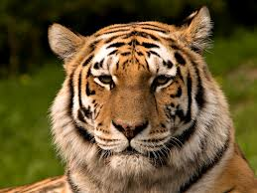
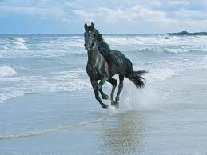
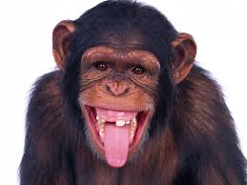
Brand Personality
1
If the brand were a living being?
Attitude | Values | Symbols
2
Synch with aspirations of the TA
3
Impacts creative and media choices

Slide 13
Articulating the brand positioning
Market Dynamics
Target Audience
Consumer Insight
Competitive Environment
Key Brand Benefit
Reason to Believe

Slide 14
Articulating the brand positioning
1
The Brand Essence
If you were to distill all the information, finally, what does the brand stand for?
Typically expressed in 2 or 3 words
“That one aspiration of the core target audience that the brand would like to uniquely own”
Dove: “Femininity restored”

Slide 15
Articulating the brand positioning
2
The Brand Positioning Statement
Culmination of all the knowledge into one single sentence that defines the brand
Dove soap: “Dove is a premium beauty bar for the mature women, worried about their skin, which won’t dry your skin like soap because it contains one quarter moisturizing cream”

Slide 16
Communication strategy flows from the brand strategy
Creative Strategy
Media Strategy
Tone, manner, mood, character
Media selection
Choice of models / ambassador
Media vehicle selection
Integration with media strategy
Activation content / distribution

Slide 17
Now, it’s your move.
Dhruv Shenoy | dhruv@knowience.com | Connect with me on

